Slide 1
University 101s
International Student Finance
Wednesday, June 29th, 2022
Jass Saini
International Student Financial Advisor
Enrolment Services, Office of the Registrar
Jaeeun Lee
Advisor, International Student Transition Support
International Student Services

Slide 2
By the end of this session, you will:
Learn about different payment methods for International students and their processing times
Learn how to print payment receipts using student portal
Learn how to print your confirmation of registration
Learn how to submit Service Request to change/update your residency status
Learn how to submit Third Party Sponsorship application
International Student Scholarships and Awards
Money Smart (Financial literacy program)

Slide 4
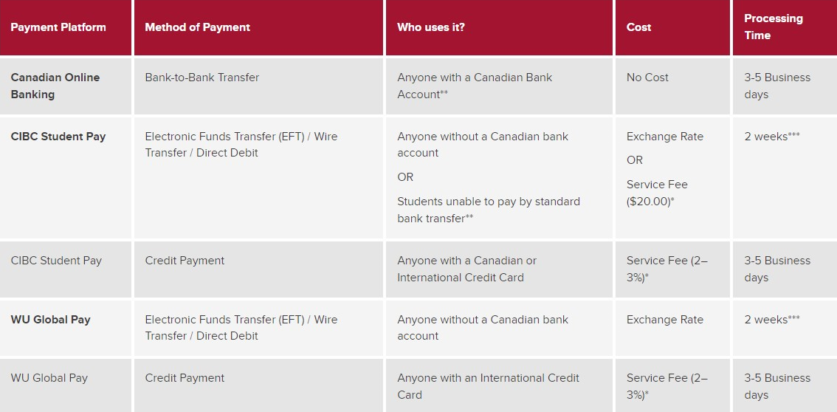
Different payment methods for International students
The preferred method of payment is through online banking with a Canadian bank account. Students who do not have a Canadian bank account can pay their fees through WU GlobalPay or CIBC Student Pay.
USEFUL LINKS:
RO Tuition and Fees Webpage: https://ucalgary.ca/registrar/finances/tuition-and-fees

Slide 5
WU Global Pay
International students who do not hold a Canadian bank account can pay their fees by a bank-to-bank transfer or credit card through Western Union GlobalPay for Students.
STEP 1
STEP 2
STEP 3
STEP 4
Access WU GlobalPay for Students.
Select Items you wish to pay. For example: Tuition, Admissions Deposit, Residence Fees etc.
Select the country where the payment is coming from.
Select the method of your payment i.e. Bank to Bank Transfer, Credit Card etc.
Add payer details and complete the payment.
Processing Times:
Bank Wire Transfer : at least 2 Weeks
Credit Card: within 3-5 Business Days

Slide 6
CIBC Student Pay
International students who do not hold a Canadian bank account can pay their fees by a bank-to-bank transfer or credit card through CIBC Student Pay.
STEP 1
STEP 2
STEP 3
STEP 4
Access CIBC Student Pay.
Select Items you wish to pay. For example: Tuition, Admissions Deposit, Residence Fees etc.
Select the country where the payment is coming from.
Select the method of your payment i.e. Bank to Bank Transfer, Credit Card etc.
Add payer details and complete the payment.
Processing Times:
Bank Wire Transfer : at least 2 Weeks
Credit Card: within 3-5 Business Days

Slide 7
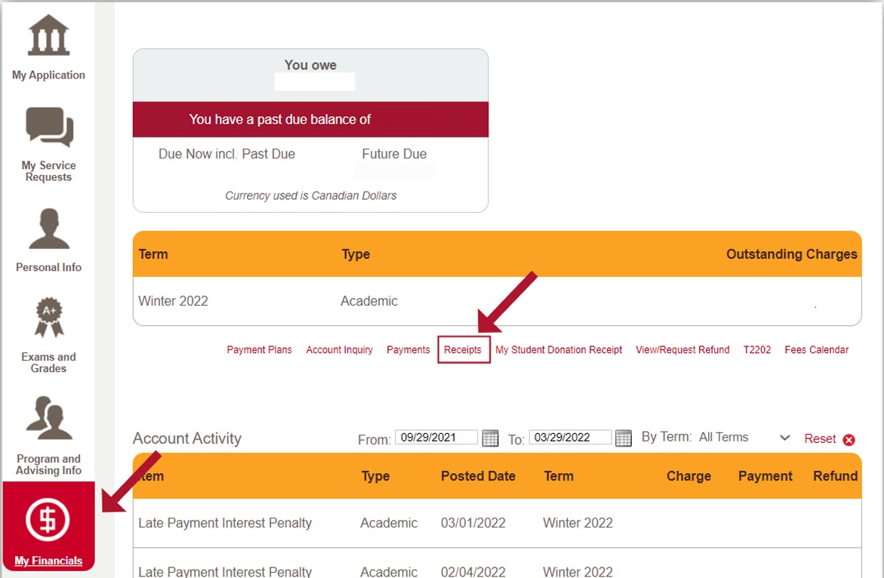
How to print your Payment Receipts
Log into the MyUofC portal (https://my.ucalgary.ca)
After logging into the MyUofC portal, click on the My Financials page and then click on Receipts.
This page will show the history of all the payments that you have done so far. Click on View to open and download the PDF copy of your payment receipt.
You will need to disable your pop-up blocker as the Payment Receipt will open in a new tab/window.
USEFUL LINKS:
How-to guide : https://ucalgary.ca/sites/default/files/teams/14/How%20to%20print%20Payment%20Receipts.pdf

Slide 8
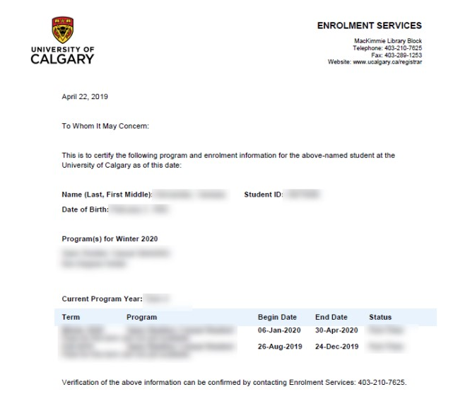
Confirmation of Registration Letters
Confirmation of Registration letters are available to registered students. They're used to confirm registration, program of study, academic standing, course load, and/or fee assessments for student loans, study permit renewal, Third Party Sponsorship approvals etc.
Student can directly access their Confirmation of Registration letters through Student Portal.
Login in MyUofC > Program and Advising Info > Confirmation of Registration
USEFUL LINKS:
How-to guide : https://ucalgary.ca/sites/default/files/teams/1/how-to-access-your-enrolment-verification-letter.pdf
Confirmation of Enrolment(webpage): https://ucalgary.ca/registrar/student-centre/confirmation-enrolment

Slide 9
Change/Update your Residency Status
If you become a Permanent Resident, Canadian Citizen, Conventional Refugee or Dependents of Consular Official (Diplomats to Canada) during your time at UCalgary, you can submit a Service Request to change your Residency status. A student’s Residency status determines if they are assessed the International or Domestic tuition rates.
The deadline to submit your supporting documents is the Term Fee Deadline to adjust fees to the domestic rate for that term. Requests received after the term fee payment deadline will take effect during the next academic term in which the student is registered as per the Academic Calendar.
List of acceptable documents:
Canadian Passport, Citizenship certificate or card
Permanent Resident Card, Confirmation of Permanent Residence (COPR) from IRCC
Notice of Decision issued by Immigration and Refugee Board (Note: As per Alberta Education and Technology (AET) guidelines, International Fee exemptions are not granted for Refugee Claimants awaiting decision).
Passport with proof of diplomatic status, diplomatic status card, official letter from head of diplomatic station
USEFUL LINKS:
How-to guide: https://ucalgary.ca/sites/default/files/teams/14/How-to-update-or-change-your-Residency-Status.pdf
Updating Personal Information: https://ucalgary.ca/registrar/student-centre/updating-personal-information

Slide 10
Third Party Sponsorship
If your tuition and fees are being paid in whole by a third party with minimal exclusions, follow the steps below to apply for a Third Party Sponsorship. Sponsors can be government agencies, companies, First Nations/Métis/Inuit groups etc.
Note: Individuals, parents, and other relatives are not eligible to act as sponsors. RESP providers are not considered eligible sponsors.
STEP 1
STEP 2
STEP 3
Sponsorship letters must include the following:
Be on company letterhead
Include the individual student name and UCalgary student ID number
Clearly state what term the sponsorship covers (EG: Fall 2022)
Outline in detail which fees will be covered or excluded in the sponsorship
Upload your sponsorship letter through an application each term prior to the term fee deadline through a Student Service Request in the Student Centre.
Service Request must be submitted before the Term Fee Deadline.
UC Finance will send an invoice to your sponsor and payment will be posted on you account once it is received from the sponsor.
TPS applications submitted late will subject to delay in processing and any late interest or holds assessed to the account due to late submission will be the responsibility of the student.
USEFUL LINKS:
Third Party Sponsorship Information Page: https://ucalgary.ca/registrar/finances/tuition-and-fees/third-party-sponsorship
Sponsorship Letter Template: https://ucalgary.ca/sites/default/files/teams/14/TPS-letter-template-and-instructions.pdf
How to submit Service Request for TPS: https://ucalgary.ca/sites/default/files/teams/14/How%20to%20-%20Submit%20a%20Third-Party%20Sponsorship.pdf

Slide 11
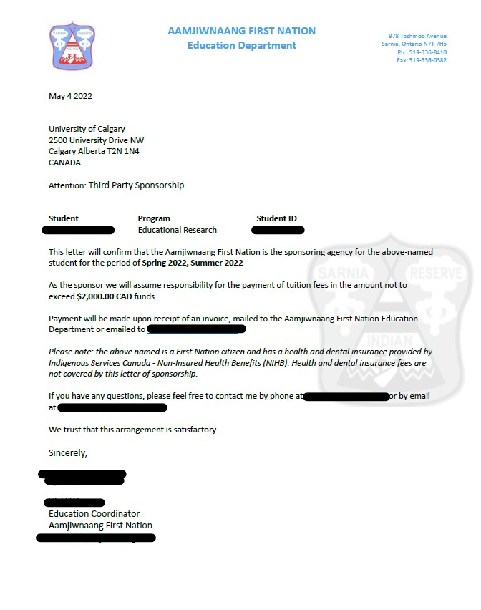
Example of a Sponsorship Letter
Student Name Program Name Student ID Term Email Exclusion Details Sponsor’s Address

Slide 12
Opening a Canadian Bank account
If you are only in Canada for a short time (such as one academic term) and do not plan to work or receive any scholarships, then you may choose not to open a bank account. However, it’s important to have a Canadian Bank account to:
Pay for living costs.
Get money back (refunds) due to overpayment OR if you won a Scholarship and Award from UCalgary.
You should choose a bank based on the services they provide or what is important to you.
Is there a fee to open an account?
Are there monthly service charges?
Does the bank provide online banking services?
Are there transaction charges or interest rates?
Where is the physical bank located and is it convenient for you?
How to open a bank account?
Your passport or birth certificate
A second piece of identification (e.g. study permit)
Any money that you'd like to deposit
Your UCalgary Student ID card (UNICARD)
USEFUL LINKS:
Find out more: https://www.ucalgary.ca/student-services/iss/resources/banking

Slide 13
International Scholarships and Awards
UCalgary provides millions of dollars in Scholarships and Awards to its students which are not only limited to Domestic students but are available specifically for International students as well. These can be categorized as Entrance Awards, Continuing Awards, Graduating Awards etc.
To find more awards available to you, visit the “Search for Awards” page, and set your “Citizenship/Residency” to “International”.
USEFUL LINKS:
Search for Intl. Awards: https://ucalgary.ca/registrar/finances/awards-scholarships-and-bursaries/search-awards
How-to Guide: https://ucalgary.ca/registrar/finances/awards/apply

Slide 14
Money Smart (Financial Literacy Program)
Money Smart is a financial literacy program offered by UCalgary that helps students with:
Budgeting
Money Saving Strategies
Financial planning
Student can access these free resources through free workshops, webinars and one-on-one financial planning with peer mentors.

Slide 15
Contact Information: Enrolment Services
Link: https://www.ucalgary.ca/registrar/contact-us
Visit us in Room MT116 in the lobby of MacKimmie Tower
Submit a Service Request using Student Portal
Connect with one of our advisors by phone at 403.210.7625 or 1.855.246.7625 (toll-free if you're calling from Canada or the US)
Book an in-person or virtual (Zoom) advising appointment (https://calendly.com/esadvising/15min)

Slide 16
Contact Information: International Student Services
Link: https://www.ucalgary.ca/student-services/iss/contact-us
Visit us in Room MSC-275 in MacEwan Student Centre
General e-mail/ non-immigration inquiries: iss@ucalgary.ca
Immigration Inquiries: issimmigration@ucalgary.ca
15-minute drop-in advising appointments:
Tues: 10 AM - 12 PM and 1 – 4 PM /// Wed: 9 AM - 12 PM and 1 - 4 PM /// Thurs: 9 AM - 12 PM and 1 - 4 PM
Instagram: @ucalgaryiss | Events calendar: https://events.ucalgary.ca/international-student-services/

Slide 17
QUESTIONS?

